Slide 1
AI-ENABLED CHEESBOARD
DINESH A(191EI117)
MOORTHY C(191EI146)
RANJITH D(191EI154)
HIRTHICK GUHAN EK(191EI132)

Slide 2
ABSTRACT
Chess has been played for around 1500 years now. Now more popular than ever chess is being played intensively yet again. The world we live in right now is filled with people who barely have any time, it isn’t that easy anymore to just hang out with friends and play games you like. People cancel plans last minute all the time now, the option of playing chess online with people from all around the world is certainly another option as well. But staring at the screen of your computer and playing 2D chess with some random person isn’t very exciting, is it? What if you can play your favorite game, in your comfort, but on an actual chessboard with anyone from the nook and corner of the world as your opponent. That’s our product for you! The chessboard is fed with algorithms that will point to you where your opponent has moved their chess piece to. In fact, the board has been designed to give you hints if you do feel stuck at times!

Slide 3
Problem Statement Addressed
Now-a-days, people thought that playing chess games in online mode is a trend and most of the kids play chess in online mode and offline. So, there a need of using mobile phones, Laptop and PlayStation for long hours with good internet support the extended hours spent in mobile radiation irritates eyes and moreover the ads pop up will distract the kids easily. Even the kids won’t get the proper support in learning the chess game though in busy hours. There are numerous online chess games available at play store, a good internet facility is recommended to get the computer support. Even the standard chessboard game plays, need at least two people to engage with.

Slide 4
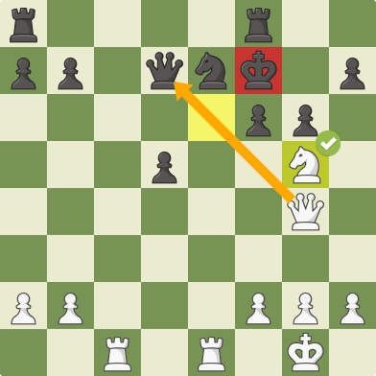
Existing Solution
As a newbie, we can play chess on a standard board with the assist of a mentor. Mentor, on the other side, would not be present at any anytime. Even if our standard chess board would not alert us if we screw up. This is an example of an existing solution. On the other side, we may play chess using software using an internet website or an app. However, a decent internet connection is required. It will not provide authentic chess experiences.

Slide 5
Proposed Solution
The beginners will get the depth knowledge and gain more experience than play in online. The chessboard will also provides the hint for the next move to keep the game interesting.
Alert the player if the rules gets broke and it will also check the moves are lawful. LED ambient design is incorporated to indicate game status and it also recommend the next step for the beginners. Intelligent backlighting with a smart control panel along with OLED assist you in taking decisions. Since it is USB-powered, the player may plug it with an adapter or with a regular battery packed.

Slide 6
Futures
You can get a hint anywhere you're having trouble moving forward, and you
won't need anyone's support there.
We installed lighting beneath the board, which will be useful during evening and night play.
Your movements will cause the light to glow. If you make a mistake, a red light will display.
You can even play alone your opponent will be the bot.
it is Easy to play.

Slide 7
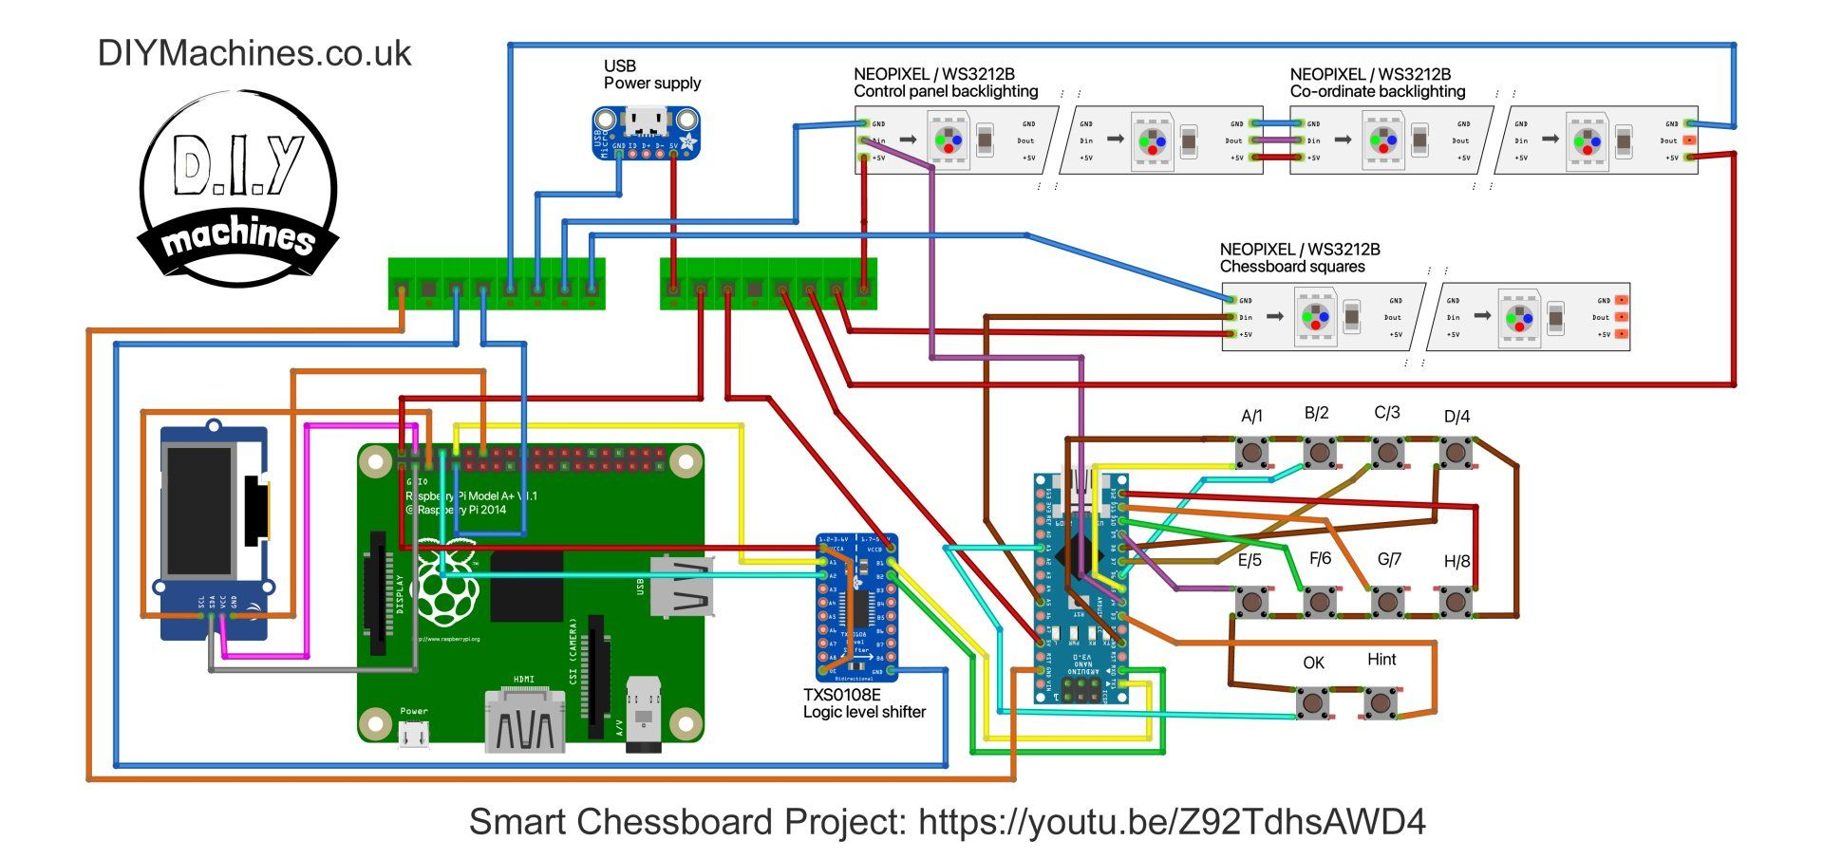
Circuit Diagram

Slide 8
Working video Link
https://youtu.be/QJv3i0tltyY

Slide 9
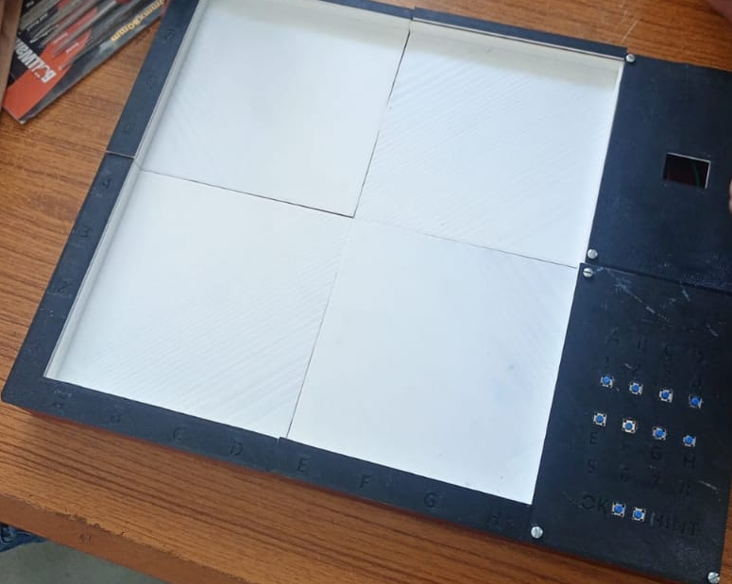
Prototype
(work is on process)

Slide 10
Component and cost
(x86) Neo pixels/WS3212b on a 30 per meter roll.
(x10) 6x6x5mm tactile momentary push buttons –
(X1) Arduino Nano.
(X1) Raspberry Pi (Zero can cope but recommend model 3 A+)
(X1) Micro SD Card 8Gb or higher for Raspberry Pi.
(X1) Logic level shifter .
(x1) USB female DIP board .
(X1) 0.96 Inch OLED screen .
Total 8000

